Slide 1
Identifying Phishing URLs through Machine Learning
Group 1
Eugene Wee (U2120698A), Clare Yeo(U2122615F), Guo Zhiqi (U2120848E)
Notes:
Hi everyone, we are Group 1 consisting of Eugene, Clare and Zhiqi

Slide 2
TABLE OF CONTENTS
02
03
DATA PREPARATION
MACHINE LEARNING
01
06
PROBLEM STATEMENT
LESSONS LEARNT
04
05
MODEL IMPROVEMENTS
MODEL ENSEMBLING
Data cleaning & Principal Component Analysis (PCA)
Conduct 2 rounds of model building and evaluation
Problem of identifying
phishing URLs
Key learning points from this Mini-Project
Conduct Feature Selection and select key variables
Conduct ensembling with the 3 models
Notes:
We will first be going through the problem statement and Data Preparation, afterwards we will move on to the building of our machine learning models, Model Improvements as well as model ensembling. Lastly, we will touch on the lessons learnt from this project.

Slide 3
01
PROBLEM
STATEMENT
Phishing is a form of fraud in which the attacker learns sensitive information of users, by masquerading as a reputable entity or person in email or other communication channels.
URL phishing can lead to usernames, passwords, credit cards, and other personal information being stolen.
Notes:
The problem we’ve identified is the prevalence of phishing scams around the world.
So, what is phishing and why is it dangerous? Phishing is a form of fraud in which the attacker learns sensitive information of users, by masquerading as a reputable entity or person in email or other communication channels. URL phishing can lead to usernames, passwords, credit cards, and other personal information being stolen. Thus, phishing scams are a huge threat.

Slide 4

PROBLEM
The number of phishing scams in Singapore jumped from 16 cases in 2017 to 5,020 in 2022.
Notes:
In fact, the number of phishing scams in Singapore jumped from 16 cases in 2017 to 5,020 in 2022.

Slide 5

OUR GOAL
PHISHING URL DETECTION
We aim to identify important features of phishing URLs and with this information, create a Machine Learning model to detect phishing URLs.
Notes:
Therefore, In light of this growing concern, our group aims to identify important features of phishing URLs and with this information,create a Machine Learning model to detect phishing URLs.

Slide 6
02
DATA PREPARATION
Notes:
I’ll first begin by discussing our data preparation process.

Slide 7
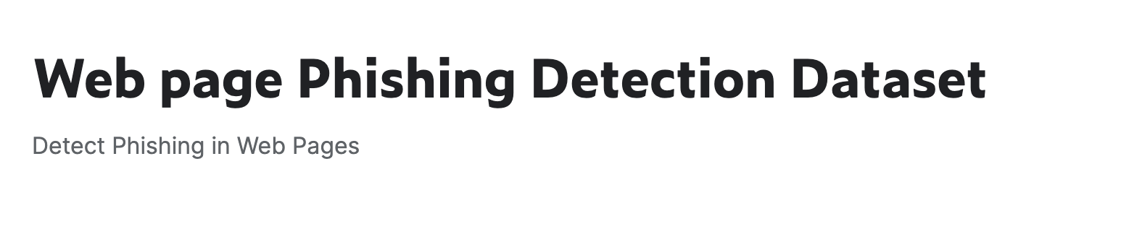

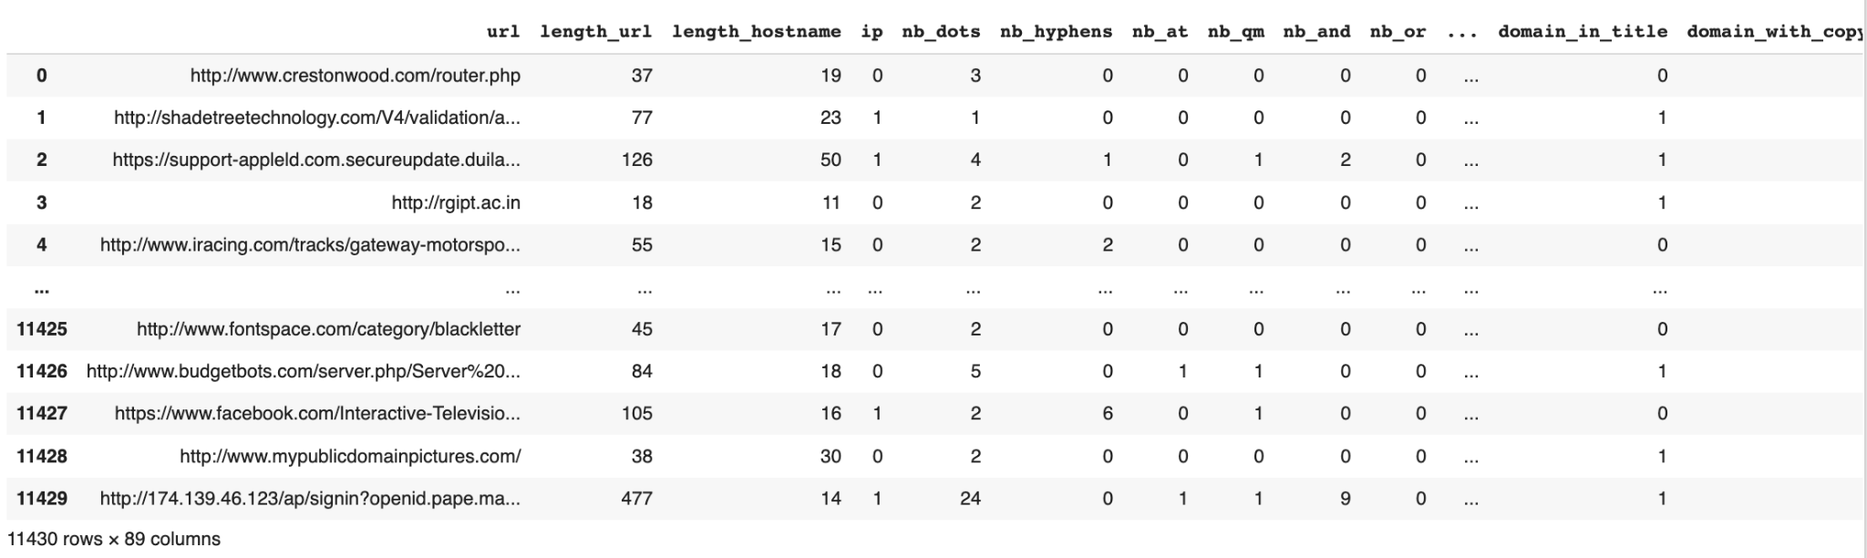
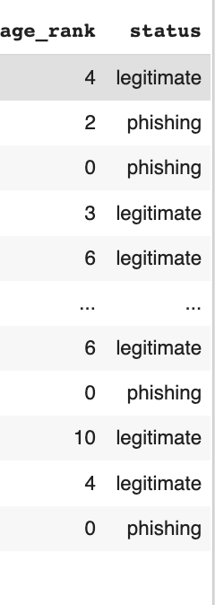
RAW DATA
Size of Dataset: 11430 URLs, 89 columns (with 87 features)
Response Variable
Notes:
Firstly, We obtained our raw data from this Web Page Phishing Detection Dataset from kaggle. The dataset includes 11430 URLs with 87 extracted features, for example, length of url, length of hostname, number of dots etc. The last column of the dataset is our response variable as it shows the status of each URL - whether it is phishing or legitimate.

Slide 8
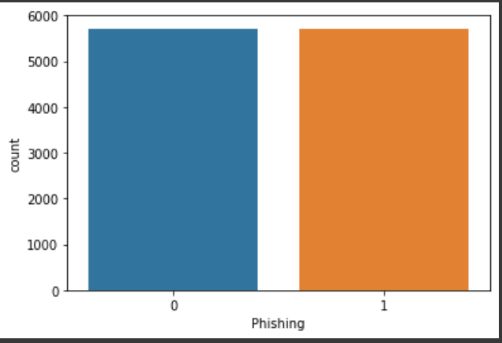
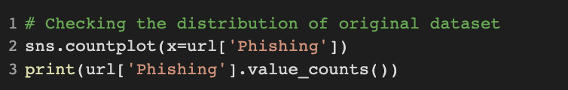
PRELIMINARY EXPLORATORY DATA
ANALYSIS (EDA)
Phishing: 5715
Non Phishing: 5715
Balanced Dataset!
No. of Phishing & Non Phishing URLs (Barplot)
Notes:
Then, we checked the distribution of our dataset and found that there was an equal number of non-phishing and phishing URLs of 5715.

Slide 9
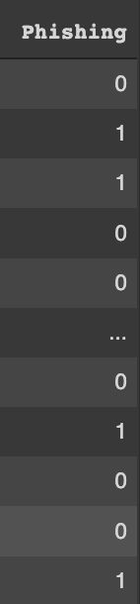
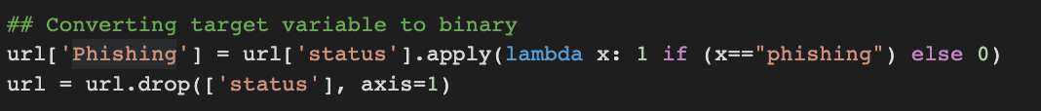
DATA CLEANING
Dropped
Notes:
We conducted our preliminary Exploratory Data Analysis. We created a new column “Phishing” which converts the response variable to binary, with legitimate as 0 and phishing as 1. And we dropped the status variable altogether. This makes it easier for us to manipulate our data later.

Slide 10
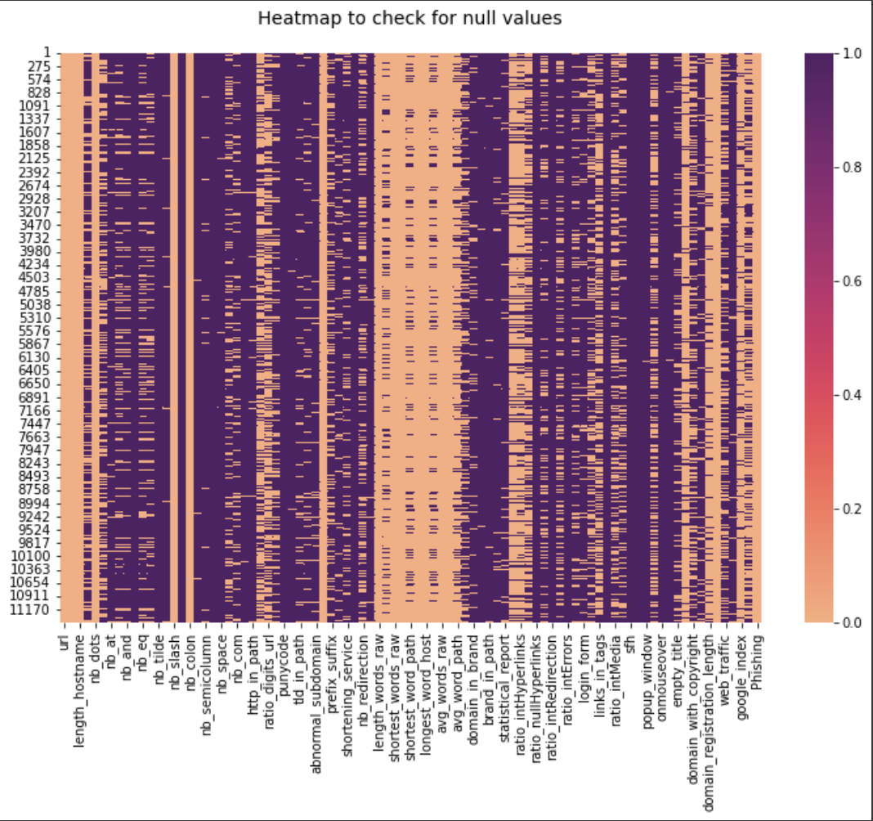
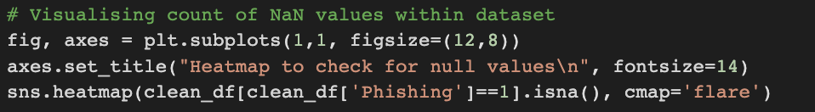
Removing Irrelevant Columns
1) Convert all values of 0 to NaN
2) Irrelevant Columns:
Columns categorised under phishing, but all values are 0. Thus, do not contribute to Phishing URLs.
Heatmap to Visualise Columns with all NaN:
Notes:
Firstly, we convert all values of 0 to Nan.
Next, we identify the irrelevant columns By first filtering out the phishing dataset, then identifying irrelevant columns as the columns with all 0s.
We plotted a heatmap to visualise the count of Nan values in the dataset. Columns that are entirely purple, are irrelevant columns with all null values, thus they do not contribute to Phishing URLs.

Slide 11
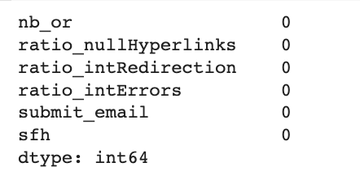
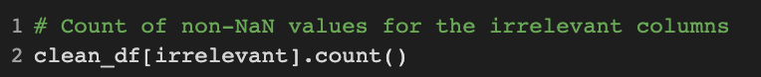
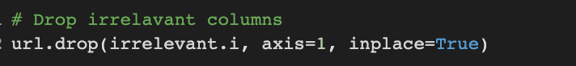
Removing Irrelevant Columns
1) Convert all values of 0 to NaN
2) Irrelevant Columns:
Columns categorised under phishing, but all values are 0. Thus, do not contribute to Phishing URLs.
Irrelevant Columns:
3) Remove Irrelevant Columns
Remaining No. Columns: 83 Columns
Notes:
We extracted these 6 irrelevant columns and dropped these from the dataset.
After removing these columns, we are now left with 83 columns.

Slide 12
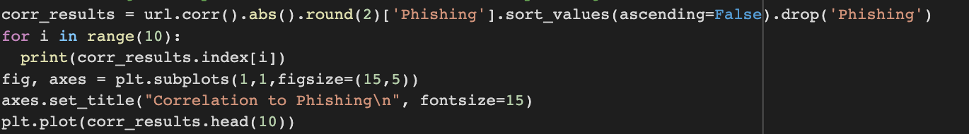
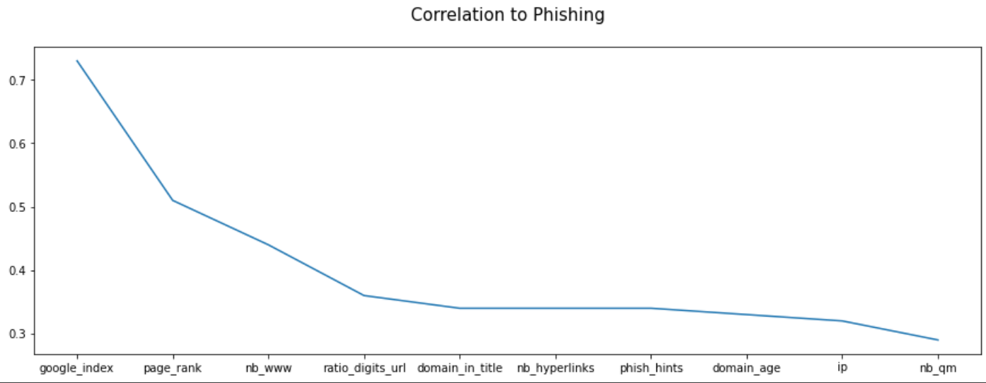
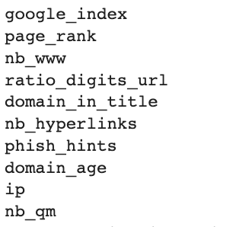
SUBSEQUENT ANALYSIS
Correlation of Variables to Phishing
Visualisation(Line Plot):
Top 10 Variables with Greatest Correlation to Phishing:
Notes:
For our Subsequent Analysis, we plotted the correlation of each variable to Phishing on a line graph. Then, we identified the top 10 variables with highest correlation to Phishing as shown here,

Slide 13
03
MACHINE LEARNING
Notes:
The problem we’ve identified was the difficulty in identify Phishing URLS.
So, what is phishing? Phishing is a form of fraud in which the attacker learns sensitive information of users by sending as a reputable entity or person in email or other communication channels. URL phishing can lead to usernames, passwords, credit cards, and other personal information being stolen.
In fact, the number of phishing scams in Singapore jumped from 16 cases in 2017 to 5,020 in 2022.

Slide 14
MACHINE LEARNING PIPELINE
1
2
3
4
ENSEMBLING
DATA
PREPARATION
HYPER PARAMETER TUNING
FEATURE SELECTION
Principal Component Analysis (PCA)
Tuning using GridSearchCV
Selection based on Feature Importance
Voting from all 3 models

Slide 15
DATA INPUTS FOR MODEL TRAINING
ROUND 1
Principal Component Analysis (PCA)
ROUND 2
PCA +
Feature
Selection

Slide 16
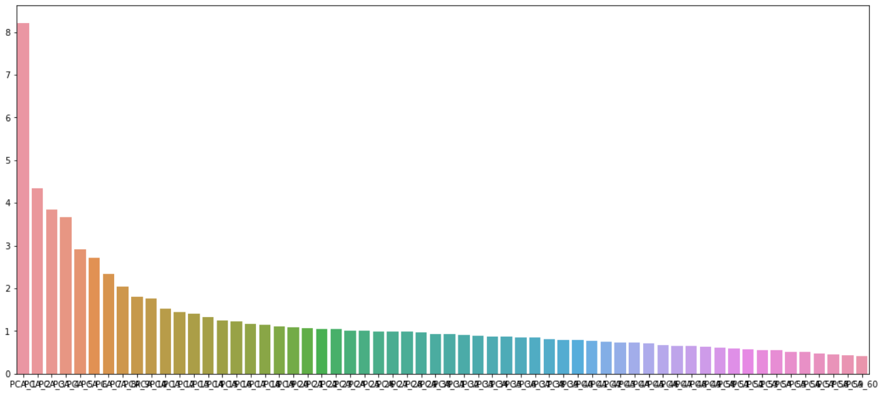
PRINCIPAL COMPONENT ANALYSIS (PCA)
Purpose of PCA
Tackle the curse of dimensionality of large datasets
Gets rids of noisy data
Reduce overfitting
PCA (95% Explained Variance)
Dimensionality reduction of
83 variables to 60 components
Extracting strongest features from the sample data

Slide 17
MACHINE LEARNING MODELS
RANDOM FORESTS
DECISION TREE
LOGISTIC REGRESSION

Slide 18
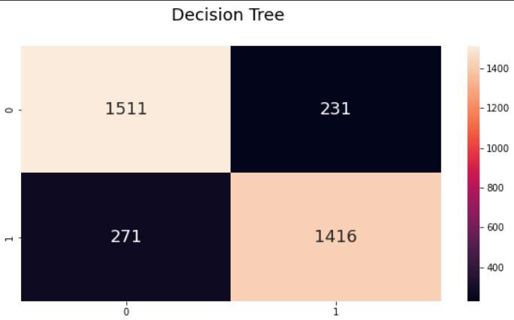
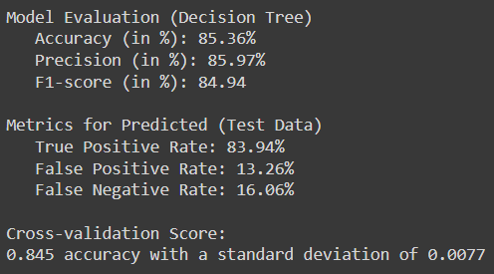
DECISION TREE
Classifies the binary response variable (Phishing URL) based on different features of the URL
MODEL EVALUATION
BASE-CASE FOR COMPARISON

Slide 19
MACHINE LEARNING MODELS
RANDOM FORESTS
DECISION TREE
LOGISTIC REGRESSION

Slide 20
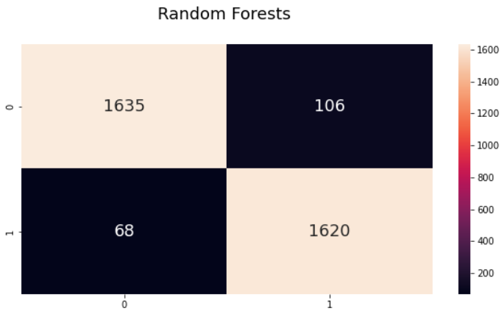
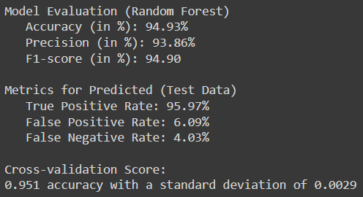
RANDOM FORESTS
Constructs multiple decision trees and takes the majority vote for classifying the response variable
MODEL EVALUATION
9% increase in Classification Accuracy
12% reduction in False Negative Rates

Slide 21
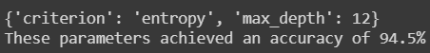
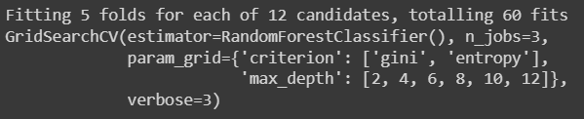
GRIDSEARCHCV (RANDOM FORESTS)
Tests all parameter combinations and returns the best parameters using Cross-Validation method
GridSearchCV Parameters
Max_depth = {2,4,6,8,10,12}
Criterion = {‘Gini’, Entropy’}
Results:

Slide 22
MACHINE LEARNING MODELS
RANDOM FORESTS
DECISION TREE
LOGISTIC REGRESSION

Slide 23
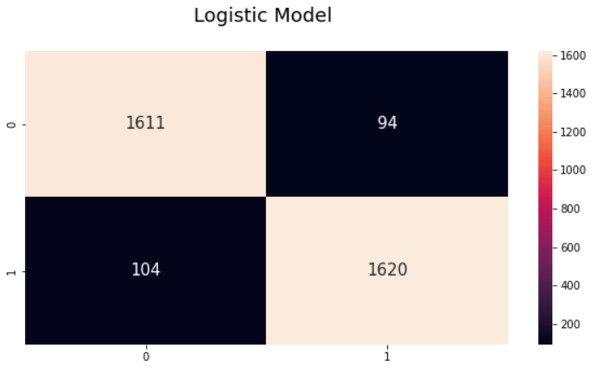
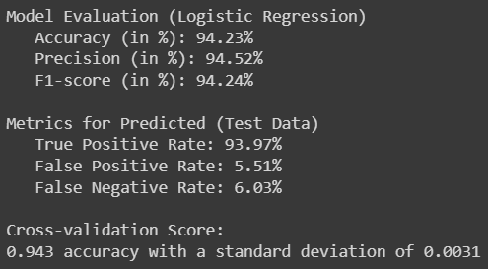
LOGISTIC REGRESSION
Modelling the probability of discrete outcome based on feature variables
MODEL EVALUATION
9% increase in Classification Accuracy
10% reduction in False Negative Rates

Slide 24
04
MODEL IMPROVEMENT
Notes:
The problem we’ve identified was the difficulty in identify Phishing URLS.
So, what is phishing? Phishing is a form of fraud in which the attacker learns sensitive information of users by sending as a reputable entity or person in email or other communication channels. URL phishing can lead to usernames, passwords, credit cards, and other personal information being stolen.
In fact, the number of phishing scams in Singapore jumped from 16 cases in 2017 to 5,020 in 2022.

Slide 25
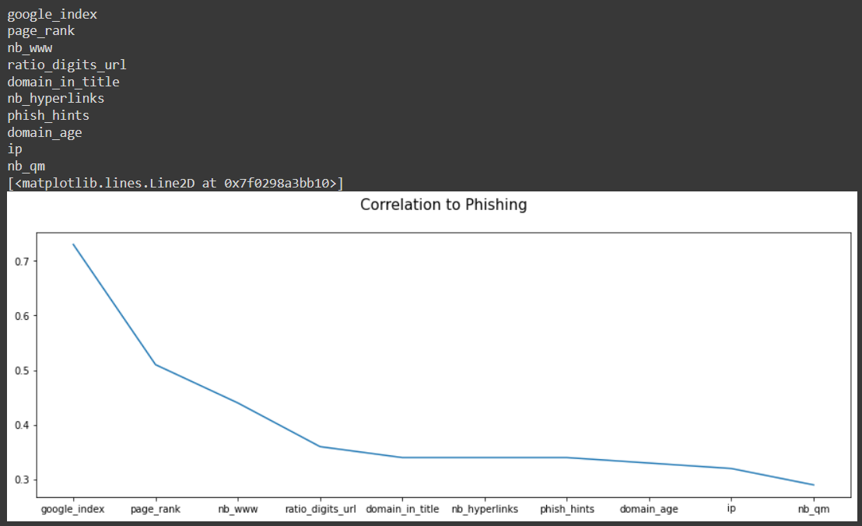
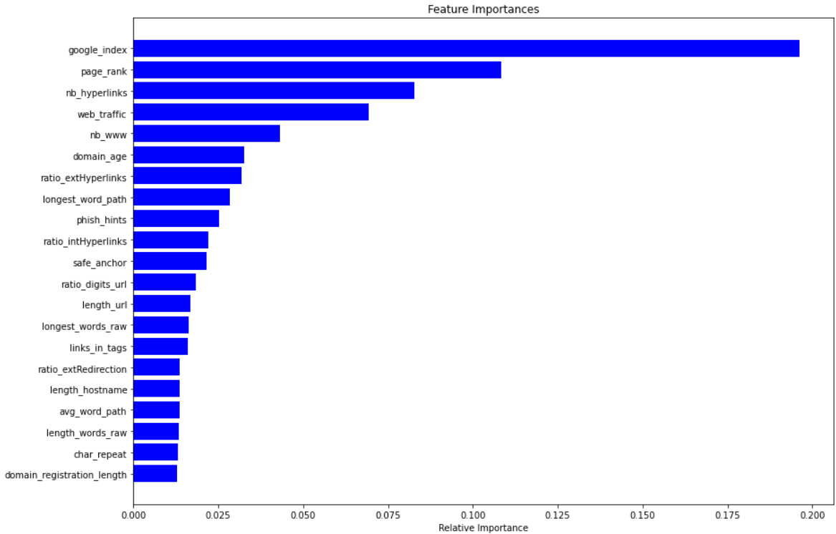
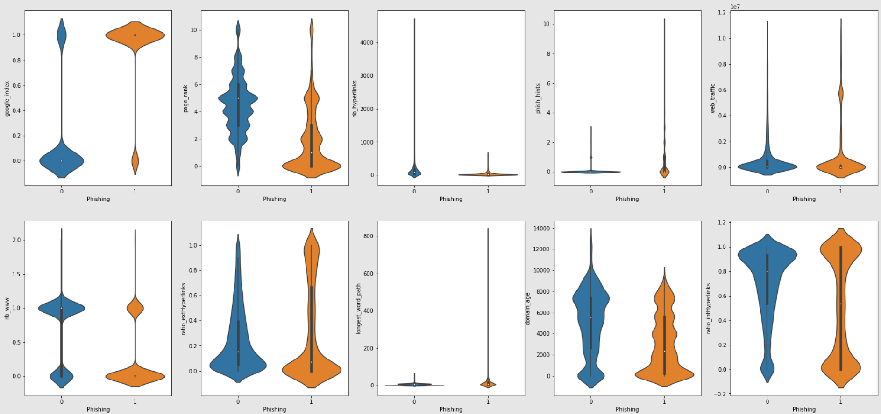
FEATURE SELECTION
Selecting features based on importance & Including them as independent model inputs
To be excluded

Slide 26
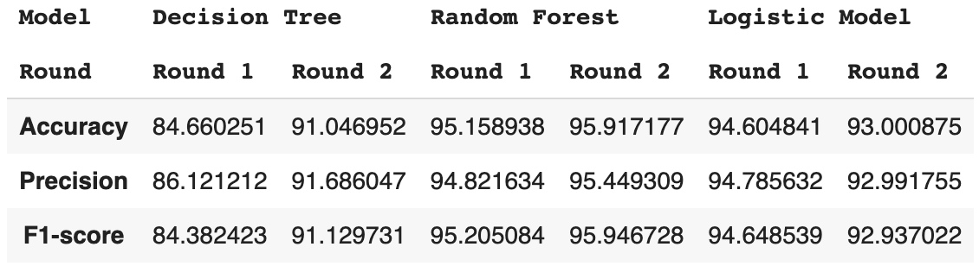
MODEL COMPARISON
Comparing the different Models based on Accuracy, Precision, F1-score with and without feature selection

Slide 27
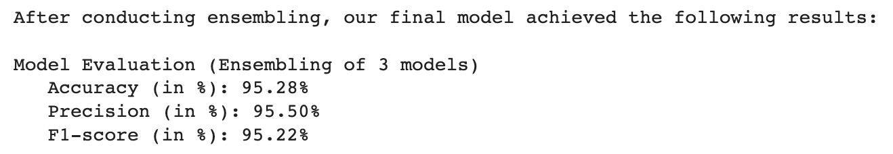
MODEL ENSEMBLING
Use of hard voting method to ensemble the 3 machine learning models

Slide 28
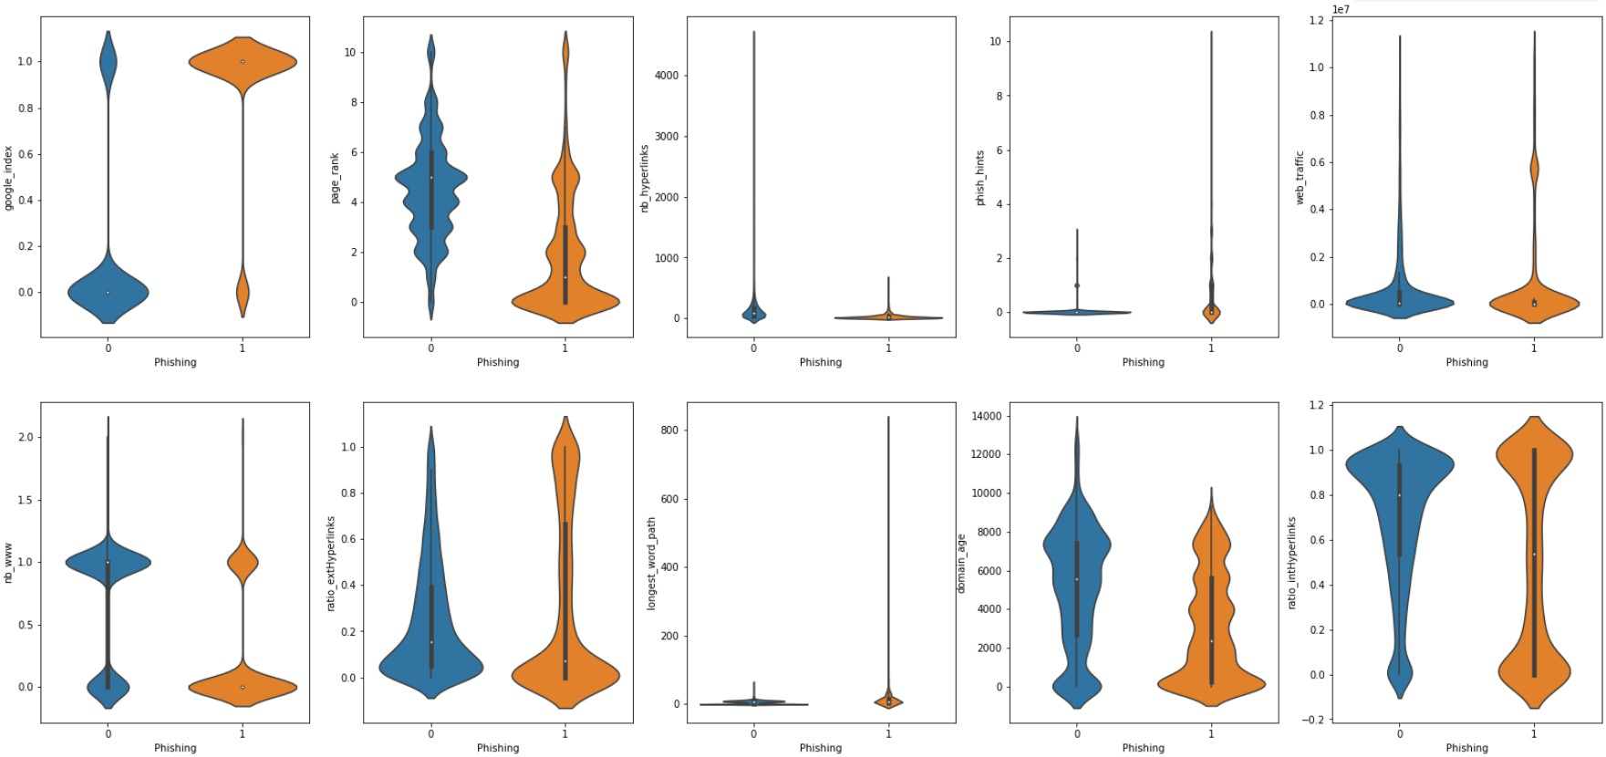
DATA-DRIVEN INSIGHTS
We can carry out quick prediction based on the components determined in feature selection

Slide 29
LEARNING OUTCOMES
#1
#3
EUGENE WEE
GUO ZHIQI
#2
Using PCA to reduce dimensionality of the dataset to tackle curse of dimensionality
CLARE YEO
Ensembling of different models to obtain the aggregated result to improve model performance
Hyperparameter tuning using GridSearchCV

Slide 30
THANKS

Slide 31
REFERENCES
KAGGLE DATASET: https://www.kaggle.com/shashwatwork/web-page-phishing-detection-dataset?select=dataset_phishing.csv

Slide 32
CREDITS
This is where you give credit to the ones who are part of this project.
Did you like the resources on this template? Get them for free at our other websites.
Presentation template by Slidesgo
Icons by Flaticon
Infographics by Freepik
Images created by Freepik
Author introduction slide photo created by Freepik
Text & Image slide photo created by Freepik.com

